Slide 1

Chapter 29 - Epigenetic Control of Immunity
Brian Wiley

Slide 2
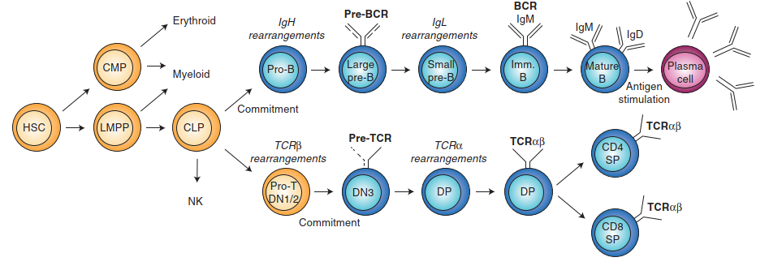
Hematopoiesis
HSC: Hematopoietic Stem Cell, LMMP: lymphoid-primed multipotent progenitors, CMP: common myeloid progenitor,
CLP: common lymphoid progenitor
Notes:
Basically just an overview of the differentiation paths of Hematopoietic Stem Cells. We will specially paying attention to B-cell lineage but as you can see where we have two phase rearrangements in B-cells, the same goes for T-cell. Heavy chain rearrangements during Pro-B stage.

Slide 3
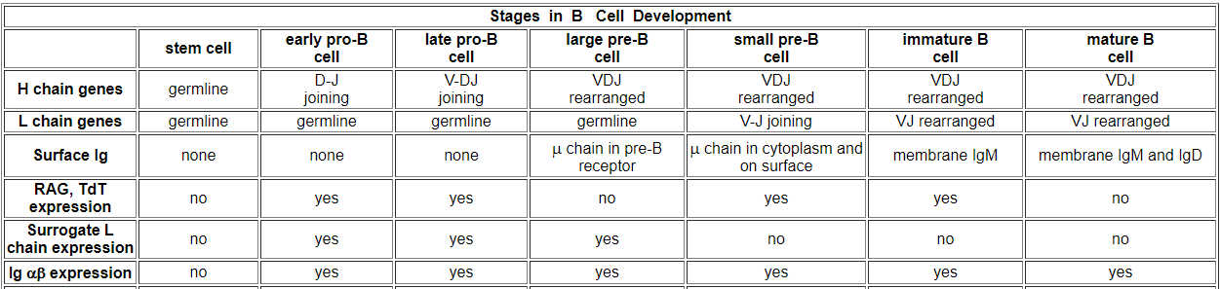
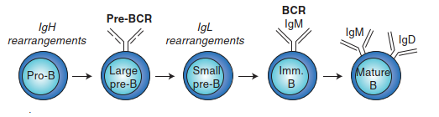
B-cell Development
Decker ²
IgH gene expresses Igµ protein at Pre-BCR
Pre-BCR expression induces proliferative expansion and downregulation of recombinase-activating genes (RAG1 and RAG2)¹
http://www2.nau.edu/~fpm/immunology/Exams/Bcelldevelopment-401.html
Notes:
RAG1/2 recombinases that induce rearrangements are not active post rearrangement in the appearance of surface Immunoglobin receptor chains. In Pro-B RAG are active during heavy chain variable portion rearrangement but not when the constant and variable regions are expressed as surface Ig. Then RAG become active again for light chain rearrangement but not after full Ig(mu) & Ig(delta) surface Ig are present in mature B-cells.

Slide 4
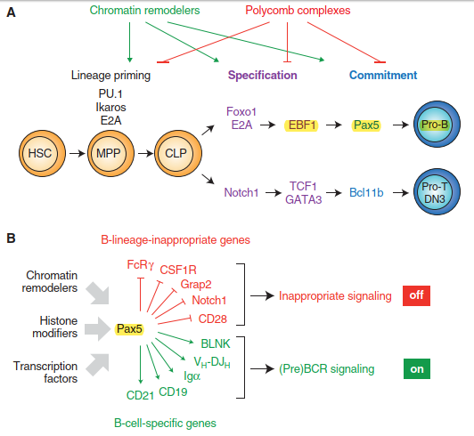
PRC2 H3K27me3 &
PRC1 H2AK119ub1
silence EBF1 and Pax5
“In conclusion, our study unequivocally demonstrates
that Pax5 does not function as a master regulator of B
cell development, as its ectopic expression is unable to
divert the HSC and erythro-myeloid progenitors B cell pathway” - Souabni, et al. (2002) ³
Notes:
Polycomb complexes obvious block lineage differentiation at various phases, MPP (MultiPotent Progenitors), CLP (Common Lymphoid Progenitors), as well as pathway to Pro-B B-cell progenitors and Pro-T T-cell progenitors. They silence Ebf1 and Pax5 (see more Pax5 next slide). Pax5 probably the most important regulator in B-cell development where blocks inappropriate lineage genes and activates many B-cell lineage genes including heavy chain. Souabni one of authors cited in text indicated they found Pax5 was not master regulator in sense of diverting the top level HSC or transdifferentiate Common Myeloid Progenitors into B-cells but once cell is a/at Common Lymphoid Progenitor, Pax5 can promote B-cell dev on T-cell dev. Chromatin remodelers as we saw in lecture 7 active lineage differentiation genes. Notch1 interesting role of Notch signaling in cancer.

Slide 5
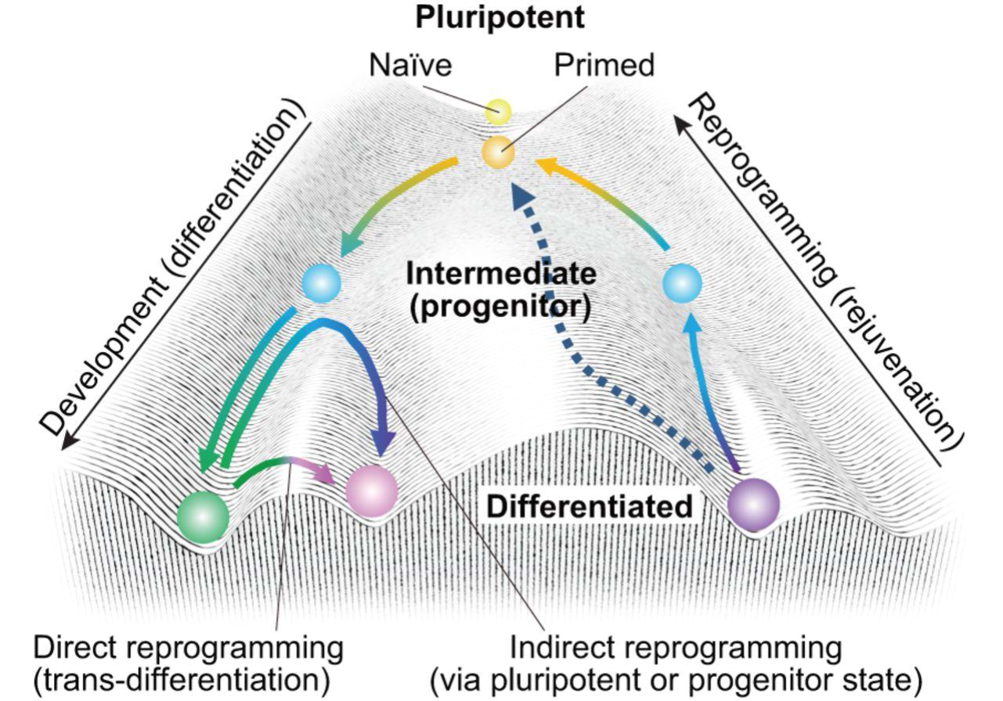
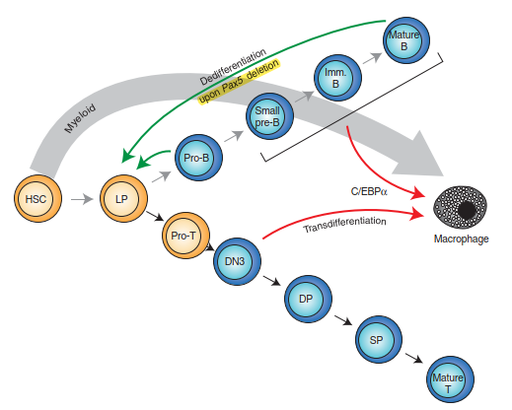
Interplay between Pax5 and Myc in B-lymphomagenesis
Study involving myc and PAX5:
https://grantome.com/grant/NIH/R01-CA102709-04
http://pathology.med.upenn.edu/department/people/505/andrei-thomas-tikhonenko
Plasticity-
mature B cells seem to lose their B-cell identity on Pax5 loss because they down-regulate B-cell-speciﬁc genes and reactivate lineage-inappropriate
genes.
Loss of Pax5 allows mature B cells from peripheral lymphoid organs to dedifferentiate in vivo back to early uncommitted progenitors that migrate to the bone marrow
Notes:
The interesting factor here is not specific to the transdifferentiation of B lymphocytes and DN3 thymocytes to mature Macrophages on the myeloid descent but that even when at fully Mature B-cell with surface Ig proteins, upon deletion of Pax5, cells can dedifferentiate and almost start over as lymphoid progenitors. This basically matches the reverse from Souabni where Pax5 is master regulator only of Lymphoid progenitors. Up here I just indicated a study back in early 2000s looking at Pax5, Myc and B-cell lymphoma at University of Penn.

Slide 6
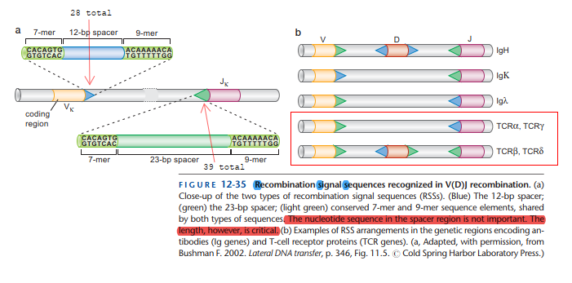
REVIEW
Watson, p. 418 ⁴
Recombination always occurs between a pair of recombination signal sequences in which one partner has the 12-bp (Blue) “spacer” and the other partner has the 23-bp (Light Green) “spacer.”
“These pairs of recombination signal sequences are organized as inverted repeats flanking the DNA segments that are destined to be joined”. (Watson 2014)
Notes:
Recombination Signal Sequences contain inverted repeats (7 and 9 bps long) destined to be joined. Recombination always occurs between at a pair where one partner is 12-bp spacer RSS (Blue) and other partner is 23-bp spacer.

Slide 7
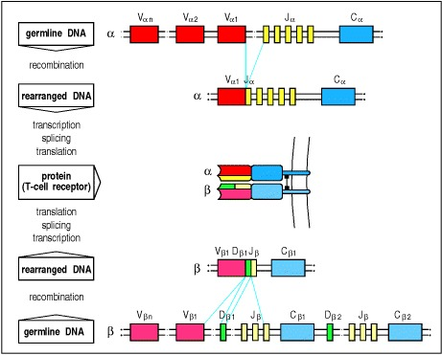
T-Cell Receptors
Recombination
Similar to B-cell
The TCRα locus, like those for the immunoglobulin light chains, contains V and J gene segments (V_{α} and J_{α}).
The TCRβ locus, like that for the immunoglobulin heavy-chain, contains D gene segments in addition to V_{β} and J_{β} gene segments.¹
Janeway, C.A. (2001) ⁵
Notes:
V(D)J recombination like B-cell as seen on previous slide.

Slide 8
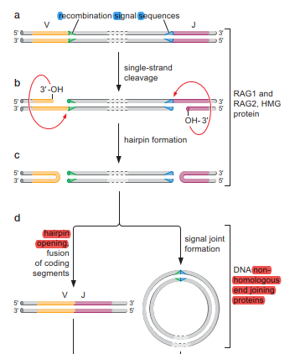
REVIEW
Non-Homologous End Joining after hairpin opening.
Notes:
First step is cleavage by RAG1/2 recombinases, assistance from Higher Mobility Group proteins. Only cleave at one 12 and one 23 bp sequence. Nucleophilic attack creates hairpin. Fusion of hairpin after opening as well as joint formation of excised sequence through NHEJ.

Slide 9
CONTROL
IgΚ or Igλ light-chain (IgL)
V(D)J recombination is tightly controlled in a lineage- and stage-speciﬁc manner.
Within the B-lymphoid lineage, the IgH locus is rearranged in pro-B cells before recombination of IgΚ and Igλ genes in pre-B cells, whereas TCRβ and TCRα genes are rearranged in pro-T (DN) and DP thymocytes, respectively (Fig. 1)
Notes:
V(D)J recombination is tightly controlled. In B-Cell heavy chain recombination/rearranging must come before light chain recombination. Similarly control of β chain recombination before α chain in TCRs.

Slide 10
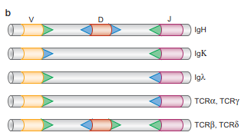
Murine –
V_{H}: 100-200
D_{H}: 12-16
J_{H}: 4
Control mechanisms must therefore exist to shield all V genes from RAG-mediated cleavage during D-J recombination and to facilitate rearrangement of only one out of 100 V genes
Process of antigen receptor generation entirely depends on accurate regulation of the accessibility of RSSs for the RAG1/2 recombinase
Each H chain has a V domain and three to four C domains.
Each L chain has a variable (V) domain and an invariant constant (C) domain.
Notes:
Control mechanisms must shield V genes from RAG proteins during initial D-J joining. Also need control to only rearrange/recombine at 1 of the 100 V genes. This is entirely dependent of accessibility of RAG recombinases to the Recombination Signal Sequences .

Slide 11
Epigenetic Regulation of RAG
Problem
The simplicity of the V(D)J recombination process at the DNA template level poses logistic problems for the assembly of the different antigen receptors because the RAG proteins are expressed in all immature B and T lymphocytes.
How to Solve
Regulation must be in place to restrict the access of RAG proteins to only speciﬁc subsets of all of the recombination substrates.
Part of Solution outside of Lymphoid Progenitors
Ig or TCR genes are present inaccessible chromatin where RAG cannot cleave.
Part of Solution in Lymphoid Progenitors
Recombinant RAG proteins added to isolated lymphocyte nuclei can only cleave the Ig or TCR gene that is actively undergoing V(D)J recombination
Notes:
V(D)J recombination is somewhat simple at DNA level. Problem is that RAG proteins expressed in all immature B and T lymphocytes, how to regulate when active? How to isolate RAG to only specific subset of RSS substrates?
Solution outside Lymphoid Progenitors – receptor genes are in heterochromatic state
Solution in Lymphoid Progenitors – RAG can only cleave regions actively undergoing recombination (what does that mean specifically? Is coming up)

Slide 12
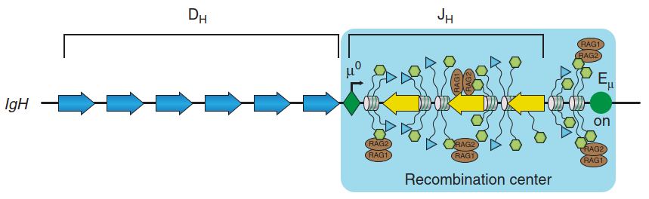
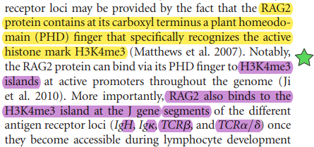
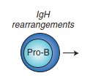
Proximal Domain
3’
The intronic Eµ enhancer and adjacent J_{H} segments are characterized by the abundant presence of the three active histone marks H3K4me2, H3K4me3, and H3K9ac in pro-B cells, where the IgH locus undergoes V(D)J recombination.
Three histone marks largely absent at V_{H} genes
Notes:
At D and J regions are epigenetic regulation in a so-called Recombination center. At the Eµ enhancer and J_{H} segments are three active marks di- and tri- methylation at H3K4 and acetylation at H3K9 in Pro-B cells. RAG2 binds tri-methylated H3K4 using PHD finger. These histone marks are absent in V_{H} genes.

Slide 13
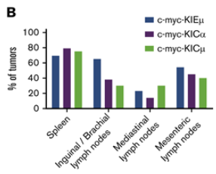
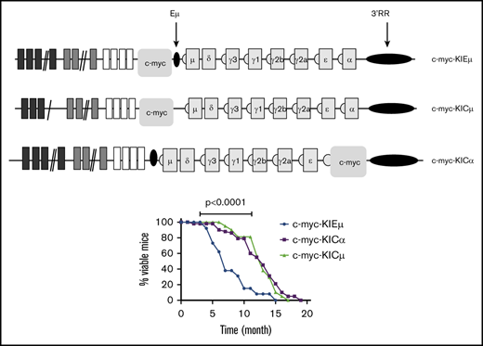
Cancer Relation – Burkitt Lymphoma and c-Myc
V D J
Why is c-Myc oncogenenic?
In 80% of cases, the translocation involves the IgH locus
Two potent enhancers E_{u} and 3’ Regulatory Region
V D J
https://ashpublications.org/bloodadvances/article/4/1/28/430038/E-and-3-RR-transcriptional-enhancers-of-the-IgH
Notes:
Study to insert c-Myc into 3 different regions/environments. 5’ potent Eu enhancer with and without Eu enhancer. And 5’ of the potent 3’RR enhancer. C-Myc is cell cycle gene and over-expression due to potent enhancer correlated to cell proliferation.

Slide 14
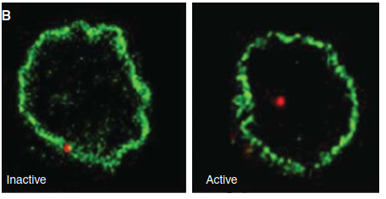
Chromatin-Mediated Function Control
In nonlymphoid cells, the Ig and TCR genes are present in inaccessible chromatin.
In non-B cells and early lymphoid progenitors, the two IgH alleles are present in heterochromatic regions at the nuclear periphery and are only relocated to central euchromatic domains during pro-B cell development when V_{H}-DJ_{H} recombination takes place ^{7.}
Remember from Chapter 19?
Left: EL-4 T cells
Right: 38B9 B cells
Kosak et al. (2002) ⁷
Notes:
As indicated In nonlymphoid cells, the Ig and TCR genes are present in inaccessible chromatin.
In T-cells and early Lympoid progenitors before Pro-B and Pro-T IgH alleles in heterochromatic region at nuclear periphery. Relocated to euchromatin during Pro-B cell development.

Slide 15
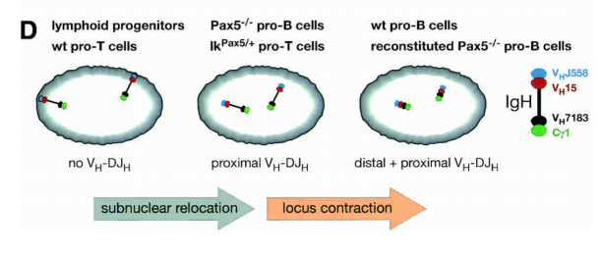
Pax5 induces V-to-DJ rearrangements and locus contraction of the immunoglobulin heavy-chain gene
Distal
Proximal
http://genesdev.cshlp.org/content/18/4/411.full.pdf
“The IgH locus is thereby anchored via distal V_{H} genes at the nuclear periphery and is oriented with the proximal IgH domain toward the center of the nucleus, facilitating DH-JH rearrangements in lymphoid progenitors” – Martin Fuxa, Abdallah Souabni 2004, Vienna Biocenter ⁸
Reconstitution of Pax5 expression in Pax5−/−
pro-B cells induced large-scale contraction
(Using retroviral vectors)
Notes:
Progenitors and Pro-T cells the Distal VH genes are at periphery. In Pax5 deficient or Pax5 knock-in Pro-T cells move to center but no contraction. WT and reconstituted (added back in) Pax5 deficient induce contraction and facilitate rearrangements.

Slide 16
Chromatin-Mediated Function
Antisense intergenic transcription throughout the V_{H} gene cluster is known to precede V_{H}-DJ_{H} rearrangements at the IgH locus in pro-B cells, suggesting that these long antisense transcripts may direct chromatin remodeling of the V_{H} gene domain
V_{H} genes do not show the active chromatin signature characteristic of expressed genes but must be accessible at the chromatin level in pro-B cells
Notes:
Antisense V_{H} transcription prior to V-DJ rearrangements induce V_{H} genes remodeling to prevent V_{H} joining before DJ joining but remain active at chromatin level.

Slide 17
CTCF!
Final project spoiler alert?? 😉

Slide 18
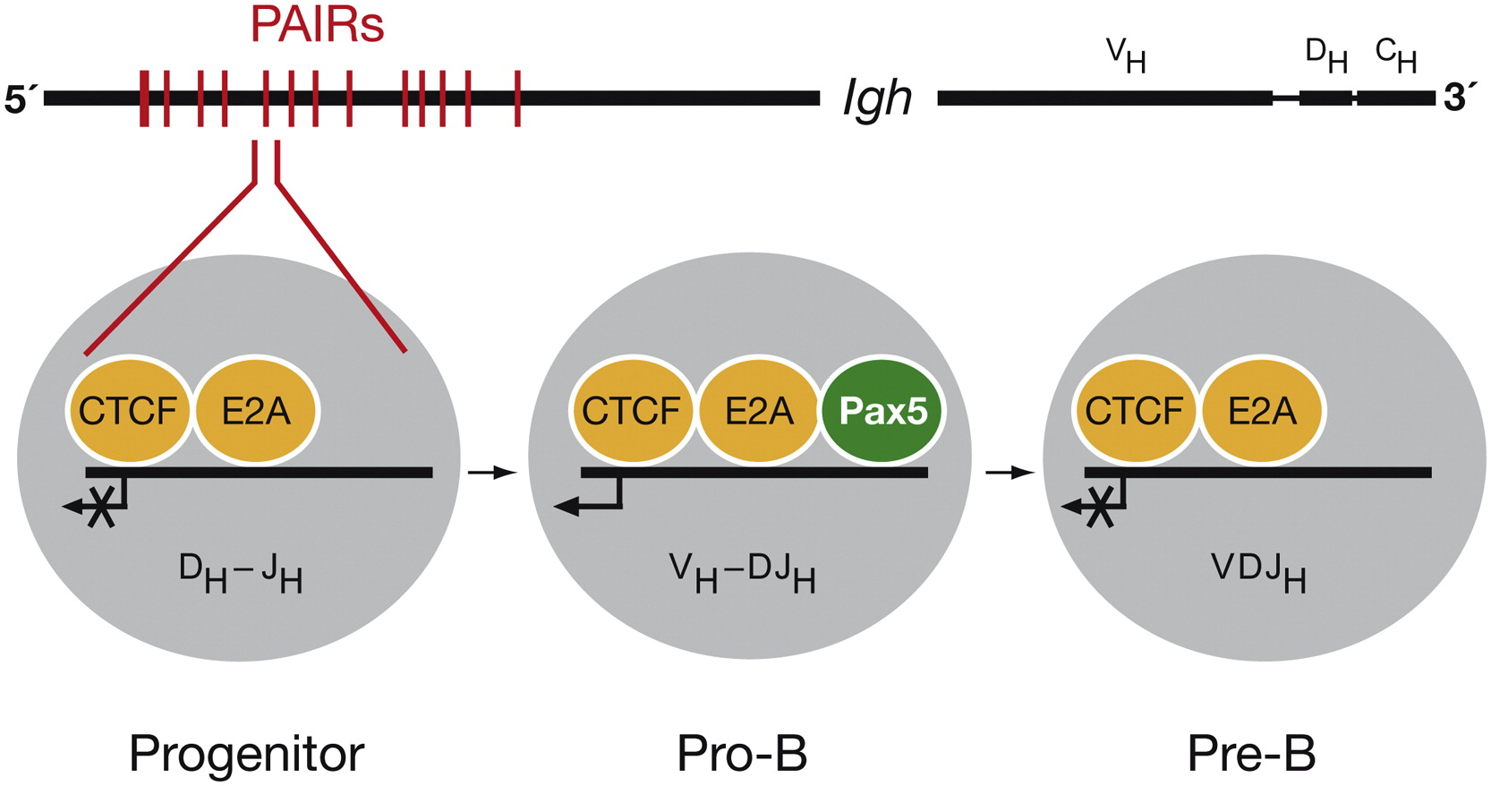
Immunity 2011 34, 175-187DOI: (10.1016/j.immuni.2011.02.005)
The distal V_{H} gene cluster contains Pax5-dependent regulatory elements (PAIR)
Pax5 induces active chromatin at PAIR elements
PAIR elements display Pax5-dependent and pro-B cell-specific antisense transcription
Pax5 binds to PAIR elements only in pro-B cells in contrast to CTCF and E2A ⁹
Notes:
Skip this from

Slide 19
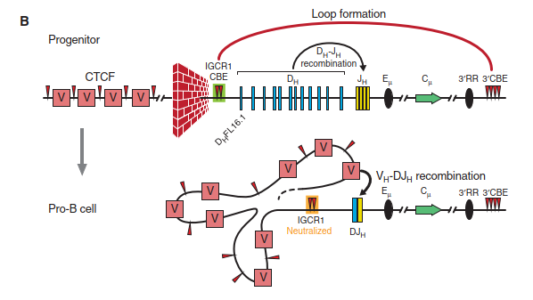
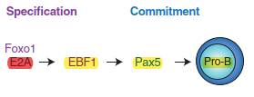
CTCF and Intergenic Control Regions (IGCR)
Notes:
IGCR binding region for CTCF to act as insulator. Wall represents blocking uncommitted lymphoid progenitors to restrict potent Eu enhancer and long-range interaction to promote D_{H}-J_{H} recombination while blocking the distal V_{H} genes. This insulator is neutralized in committed Pro-B cells possibly due to the forementioned Pax5 induced compaction on slide 15.

Slide 20
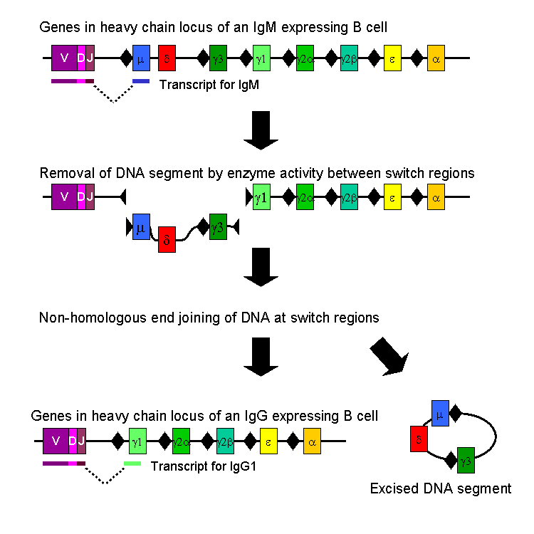
Class Switch Recombination
Constant regions are as constant as their names make them out to be.

Slide 21
Sources
Meffre, E., Milili, M., Blanco-Betancourt, C., Antunes, H., Nussenzweig, M. C., & Schiff, C. (2001). Immunoglobulin heavy chain expression shapes the B cell receptor repertoire in human B cell development. The Journal of clinical investigation, 108(6), 879–886. https://doi.org/10.1172/JCI13051. Retrieved from https://www.ncbi.nlm.nih.gov/pmc/articles/PMC200933/
Decker, J.M. B Cell Development. Immunology. Retrieved from http://www2.nau.edu/~fpm/immunology/Exams/Bcelldevelopment-401.html
A. Souabni, C. Cobaleda, M. Schebesta, M. Busslinger. Pax5 promotes B lymphopoiesis and blocks T cell development by repressing notch1. Immunity, 17 (2002), pp. 781-793. Retrieved from https://www.sciencedirect.com/science/article/pii/S1074761302004727
Watson, J.D., Gann, A., Baker, T.A., Levine, M., Bell, B.P., Losick, R., Harrison, S.C. “Binding and Unwinding: Origin Selection and Activation by the Initiator Protein.” Molecular Biology of the Gene. Seventh Edition. Pearson Education, Inc. 2014.
Janeway CA Jr, Travers P, Walport M, et al. Immunobiology: The Immune System in Health and Disease. 5th edition. New York: Garland Science; 2001. T-cell receptor gene rearrangement. Available from: https://www.ncbi.nlm.nih.gov/books/NBK27145/
Nour Ghazzaui, Hussein Issaoui, Mélissa Ferrad, Claire Carrion, Jeanne Cook-Moreau, Yves Denizot, François Boyer; Eμ and 3′RR transcriptional enhancers of the IgH locus cooperate to promote c-myc–induced mature B-cell lymphomas. Blood Adv 2020; 4 (1): 28–39. doi: https://doi.org/10.1182/bloodadvances.2019000845
Kosak ST, Skok JA, Medina KL, Riblet R, Le Beau MM, Fisher AG, Singh, H. 2002. Subnuclear compartmentalization of immunoglobulin loci during lymphocyte development. Science 296: 158–162.
Fuxa M, Skok J, Souabni A, Salvagiotto G, Rolda´n E, Busslinger M. 2004. Pax5 induces V-to-DJ rearrangements and locus contraction of the immunoglobulin heavy-chain gene. Genes Dev 18: 411–422.
Ebert A, McManus S, Tagoh H, Medvedovic J, Salvagiotto G, Novatchkova M, Tamir I, Sommer A, Jaritz M, Busslinger M. 2011. The distal VH gene cluster of the Igh locus contains distinct regulatory elements with Pax5 transcription factor-dependent activity in pro-B cells. Immunity 34: 175–187.
Notes:
Last 3 were from textbook.

Slide 22
Chapter 30 - Metabolic Signaling to Chromatin
NOT DONE YET!?!

Slide 23
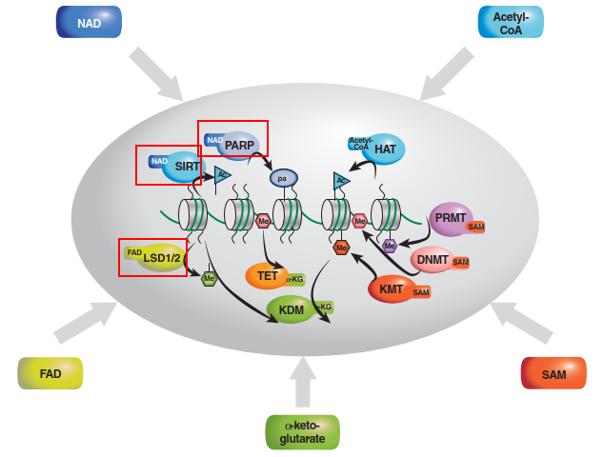
JHDMs
Notes:
Writers:
PARPs require NAD for poly-Adenylation
HAT require Acetyl-CoA
DNMTs, KMTs, PRMTs (Peptidylarginine) require SAM (S-adenosyl methionine)
Erasers:
Sirtuins are NAD dependent deacetylases
LSD1 (aka KDM1A) lysine demethylase FAD dependent (Targets H3K4me2/1 but switches to H3K9me2/1 in androgen receptor pathway, role in Colorectal Cancer)
On the other hand Jumonji domain-containing histone demethylases require alpha-Ketoglutarate
Tet enzymes are alpha-Ketoglutarate dependent in active DNA demethylation

Slide 24
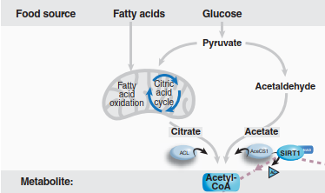
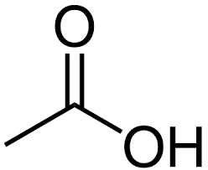
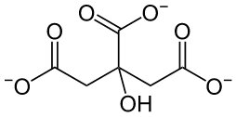
Acetyl-CoA
Knew:
Mitochondrial Pool – PDC and Fatty Acid Oxidation
Did not know:
Nuclear/Cytosolic Pool – 2 Enzymes:
acetyl-CoA synthetase 1 (AceCS1) (Acetate)
ATP-citrate lyase (ACL) (Citrate from TCA Cycle)
Interestingly HDAC Class 1/2 can produce Acetate
Cycle: 1) HDAC deacetylate 2) Acetate used by AceCS1 to synthesize acetyl-CoA 3) acetyl-CoA used to acetylate Histones
Notes:
Two Pools
Mitochondrial Pool – PDC(Pyruvate Dehydrogenase Complex) and Fatty Acid Oxidation
Nuclear/Cytosolic Pool – Responsible for Protein and Histone acetylation
2 Enzymes: AceCS1 uses acetate to synthesize acetyl-CoA while ACL uses citrate.

Slide 25

Acetyl-CoA
Loss of AceS1 or ACL leads to reduction in global histone acetylation
Supplementing acetate for AceCS1 can overcome loss of ACL
Both influence chromatin remodeling.
AceCS1 is acetylated – event controlled in cyclic manner by SIRT1
SIRT1 can increase histone acetylation??????? Indirectly???
Acetylated form Lys-661 of AceCS1 is inactive
SIRT1 deacetylation of Lys-661 in AceCS1 activates
Notes:
Loss of either enzyme reduce global histone acetylation. If we supplement acetate (substrate for AceCS1) we can overcome lost of ACL and AceCS1 can synthesize enough acetyl-CoA. SIRT1 can activate AceCS1 by deacetylation of Lys-661. SIRT1 is only sirtuin able to do this.

Slide 26
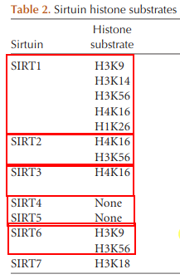
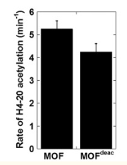
CONNECTION TIME!!
SIRT1 least specific
In Yang et al 2012 from Lecture 4 under their Experimental Procedures they used 15 μM Sirt1 and 7.5 mM NAD⁺ to deacetylate MOF autoacetylation
“Interestingly, both the autoacetylation activity and the histone acetylation activity of the deacetylated MOF were found to be very close to that of wild-type MOF, suggesting that autoacetylation of MOF only marginally modulates the enzymatic activity.” (Yang et al. 2012)
“In this study, we were able to produce MOF in the completely deacetylated form by treatment with Sirt1/NAD⁺” Yang et al (2012)¹
“These data gave strong evidence that acetylation of Lys-274 does not significantly alter MOF activity, and deacetylation at this lysine residue does not abrogate MOF activity.”
Fig 4C https://www.ncbi.nlm.nih.gov/pmc/articles/PMC3471714/
Notes:
SIRT1 show to deacetylate all 4 core histones in vitro.
In study of MOF and (MYST HAT) which uses autoacetylation, they noticed that autoacetylation only marginally increased enzymatic activity and may not be entirely required. Important since they were first to do a study of deacetylation of MOF while other studies merely just mutated the key Lysine of MOF.

Slide 27
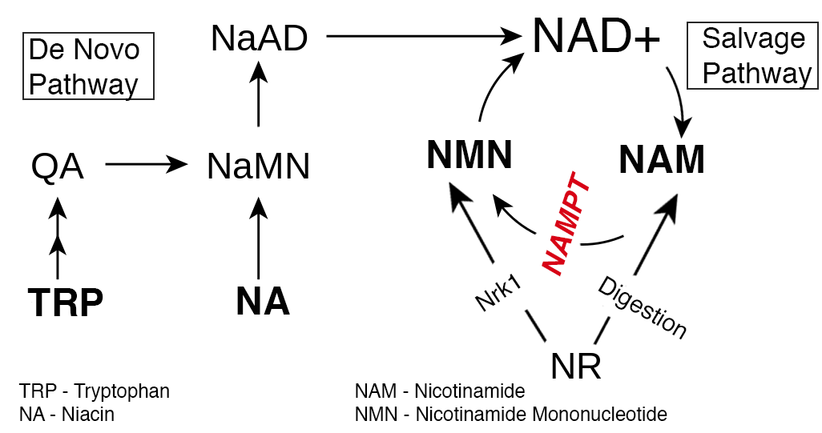
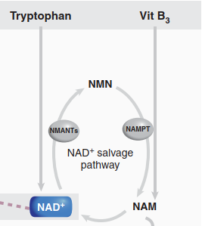
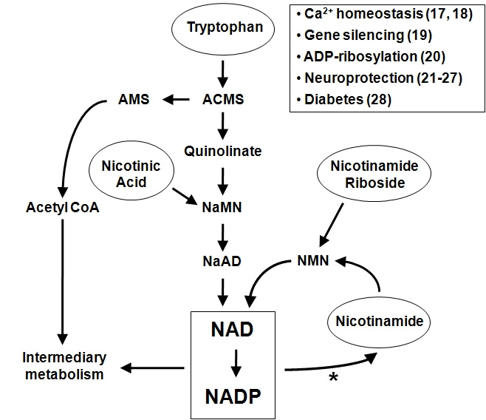
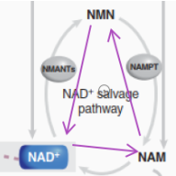
NAD+ Deacetylase Sirtuins
Taken from https://alivebynature.com/june/wp-content/uploads/nad-salvage3-3.png
Do they have it backwards?
NAD < NMN < NAM < NAD
NAD > NMN > NAM > NAD
Taken from https://www.fbsserver.org/2008/v13/af/3143/fig1.jpg
Notes:
Skip this. Just note every other resource out there indicates de novo salvage pathway is depicted in reverse but enzymes go both ways.

Slide 28
NAD+
Sirtuins and PARPs
Notes:
Not much here.

Slide 29
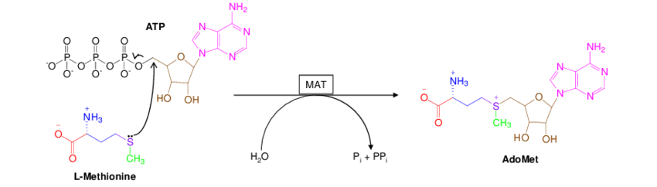
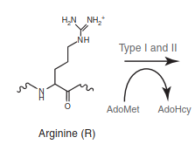
SAM - DNMT/KMT/PRMT
ATP is source or SAM. Low levels of ATP can therefore influence SAM ability.
After Methyl group is donated becomes S-adenosyl homocysteine --------| Methyltransferases.
Sufrin et al (2009)
Notes:
ATP is required for SAM synthesis. S-adenosyl homocysteine potent inhibitor of all Methyltransferases

Slide 30
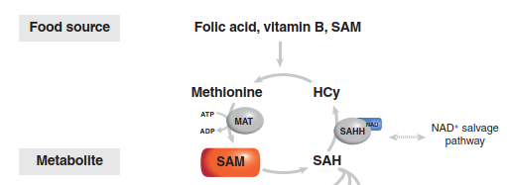
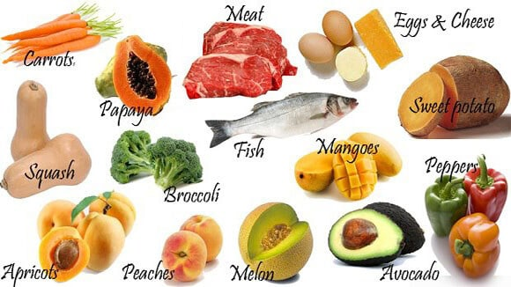

Food Sources
B Vitamins

Slide 31
FAD - Demethylase
LSD1 and LSD2 use FAD
Jumonji Family use Fe(II) and α-ketoglutarate
LSD1 enzymatic activity depends on protein kinase Cα (PKCα)-dependent phosphorylation. PKCa responds

Slide 32
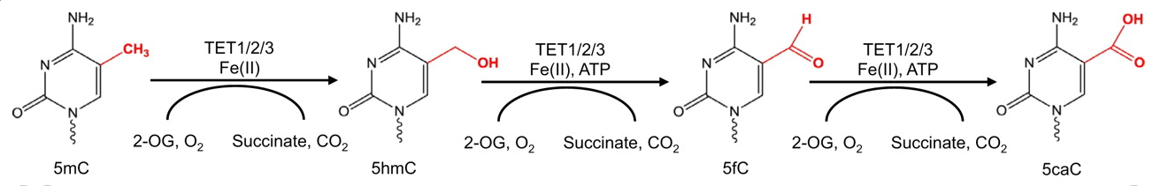
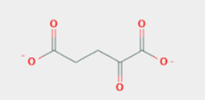
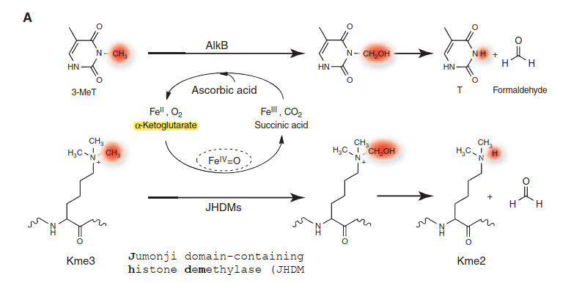
α-ketoglutarate (2-oxoglutarate)
2
1
https://dev.biologists.org/content/139/11/1895

Slide 33
α-ketoglutarate (2-oxoglutarate)
Connection Time!!!
https://dev.biologists.org/content/139/11/1895

Slide 34
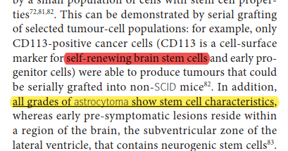
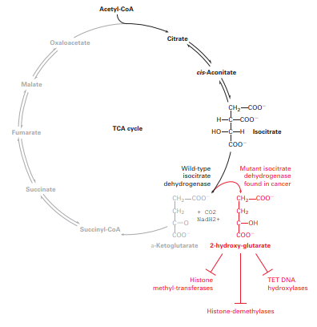
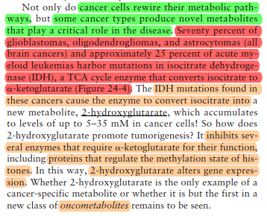
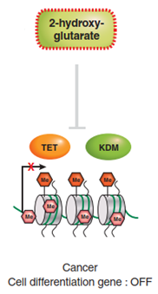
Feinberg – CD113 ²
↑2-hydroxy-glutarate ↓ Active DNA Demethylation
↑Promoter DNA CH₃ in Differentiated
Associated Genes
↓ Histone Demethylation
↑ Histone Methylation = “repression of the inducible
expression of lineage-specific differentiation genes
and a block to differentiation” – Lu, et al. (2012) ⁴
Lodish, Advanced Cell Bio II ³
One effect of DNA
hypermethylation
is blockade of cell
Differentiation” –
Bledea, et al. (2019) ⁵
???
✓
✓
https://www.nature.com/articles/s41598-019-53262-7 ⁵
https://www.nature.com/articles/nature10860 ⁴

Slide 35
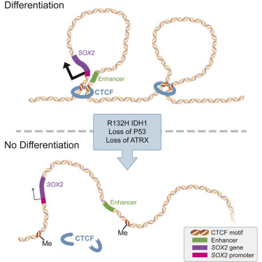
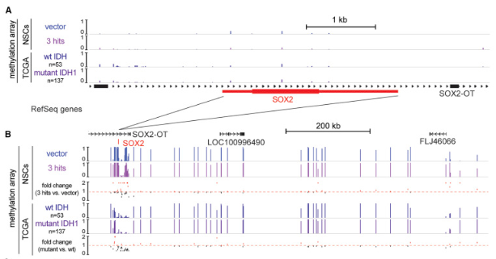
Low-Grade Astrocytoma Mutations in IDH1, P53, and ATRX Cooperate to Block Differentiation of Human Neural Stem Cells via Repression of SOX2 ⁶
Illumina 450K Methylation Array
https://www.cell.com/cell-reports/comments/S2211-1247(17)31426-2

Slide 36
Sources
Yang, C., Wu, J., Sinha, S. H., Neveu, J. M., & Zheng, Y. G. (2012). Autoacetylation of the MYST lysine acetyltransferase MOF protein. The Journal of biological chemistry, 287(42), 34917–34926. https://doi.org/10.1074/jbc.M112.359356
Feinberg, A., Ohlsson, R. & Henikoff, S. The epigenetic progenitor origin of human cancer. Nat Rev Genet 7, 21–33 (2006). https://doi.org/10.1038/nrg1748
Lodish, H., Berk, A., Kaiser, C., Krieger, M., Bretscher, A., Ploegh, H., Amon, A. and Martin, K. (2016). Molecular Cell Biology. New York: W.H. Freeman and Company.
Lu, C., Ward, P., Kapoor, G. et al. IDH mutation impairs histone demethylation and results in a block to cell differentiation. Nature 483, 474–478 (2012).
Bledea, R., Vasudevaraja, V., Patel, S. et al. Functional and topographic effects on DNA methylation in IDH1/2 mutant cancers. Sci Rep 9, 16830 (2019). https://doi.org/10.1038/s41598-019-53262-7
Modrek, A. S., Golub, D., Khan, T., Bready, D., Prado, J., Bowman, C., Deng, J., Zhang, G., Rocha, P. P., Raviram, R., Lazaris, C., Stafford, J. M., LeRoy, G., Kader, M., Dhaliwal, J., Bayin, N. S., Frenster, J. D., Serrano, J., Chiriboga, L., Baitalmal, R., … Placantonakis, D. G. (2017). Low-Grade Astrocytoma Mutations in IDH1, P53, and ATRX Cooperate to Block Differentiation of Human Neural Stem Cells via Repression of SOX2. Cell reports, 21(5), 1267–1280. https://doi.org/10.1016/j.celrep.2017.10.009
Notes:
Last 3 were from textbook.

